Slide 1
SURVEILLANCE SYSTEM FOR OFFICE
Group Members:
Tahsinur Rahman
Wasi Mohammad Fuad
Tasneem Batool
Aniqa Zaida Khanom

Slide 2
Overview of the Project
Automated single room advanced security system designed for general public use.
Bring security for each and every personnel at a reasonable price.
The security system includes multiple sensors for ensuring proper detection of intruders.
Magnetic sensor which will detect if a door or window has been opened while the system is on.
PIR sensor for detecting any kind of motion or movement of anyone entering the room.
Sends a signal to the buzzer to start ringing and a surveillance camera will capture a photo of the intruder’s face.
An email will be sent to notify about the presence of the intruder. Time and photo will be logged in the computer for further analysis.
Can be used in small office rooms, faculty or admin room in universities or school or tenants subletting their house.

Slide 3
Components
PIR Sensor Module : PIR sensor detects a human being moving around within approximately 10m from the sensor. PIR are fundamentally made of a pyro electric sensor, which can detect levels of infrared radiation.
Magnetic Door Switch Set : A small reed switch assembly specifically designed to alert when doors, drawers, or any other aperture opens. One half of the assembly set on a door frame and the other attached to the door itself. When the switch set is separated from each other the contact is broken and triggers an alarm.
Buzzer : A magnetic buzzer generates a continuous beep.
Arduino : The Arduino Uno is a microcontroller board based on the ATmega328. It has 14 digital input/output pins (of which 6 can be used as PWM outputs), 6 analog inputs, a 16 MHz ceramic resonator, a USB connection, a power jack, an ICSP header, and a reset button. It contains everything needed to support the microcontroller; simply connect it to a computer with a USB cable or power it with a AC-to-DC adapter or battery to get started.

Slide 4
Components
Web Camera Security System : Basic motion detection monitoring system.
LCD : 16x2 LCD Display will be used to exhibit a message.
Breadboard : setup of our electronic circuits
Resistors
Switch
Jumper Wires

Slide 5
Inputs:
Outputs:
PIR Sensor
Magnetic Sensor
Camera
Switch
16x2 LCD Display
Buzzer
E-mail
Image and time logs

Slide 6
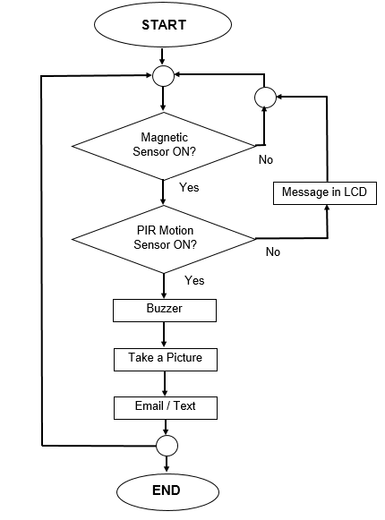
Flow Chart

Slide 7
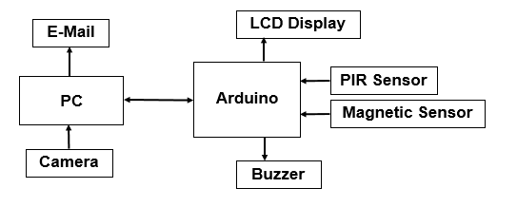
Block Diagram

Slide 8
Existing Technology
The technologies associated with our system are all existing ones that have been implemented before.
Sensors and cameras are widely used for surveillance systems which send a text or email to the owner, indicating them about an alarm [1].
We would be using a magnetic door switch set which will alert the program if an intruder opens the door [2].
The PIR sensor is one of the most widely used motion sensor that uses infrared radiation in order to detect motion within its range [3].
The program will save the information on the computer and also send a mail to the owner to warn them about a possible intrusion [5].
To alert surrounding people, we would be using a piezoelectric buzzer which is usually used in alarm devices, timers, electronic metronomes and etc [4].
The information would be displayed using a LCD display, the most commonly used display module.

Slide 9
References
Bangali, J. and Shaligram, A. (2013). Design and Implementation of Security Systems for Smart Home based on GSM technology. International Journal of Smart Home, 7(6), pp.201-208.
F.S. (2015). MICROCONTROLLER BASED SMART HOME WITH SECURITY USING GSM TECHNOLOGY. International Journal of Research in Engineering and Technology, 04(06), pp.20-28.
S. Izzal Azid and S. Kumar, “Analysis and Performance of a Low Cost SMS Based Home Security System”, International Journal of Smart Home, vol. 5, no. 3, (2011) July, pp. 15-24.
Malarvizhi, C., Kalaipoonguzhali, V. and Anitha, J. (2017). Microcontroller ATmega 328Pand GSM Based Advanced Home Security System. International Journal of Smart Home, 11(6), pp.11-20.
Mustafijur Rahman, A.H.M Zadidul Karim, Sultanur Nyeem, Faisal Khan, Golam Matin,"Microcontroller Based Home Security and Load Controlling Using Gsm Technology", IJCNIS, vol.7, no.4, pp.29-36, 2015.DOI: 10.5815/ijcnis.2015.04.04

Slide 10
THANK YOU!

